Slide 1

By AJ

Slide 2
Why we need this ?
What is the benefit ?
Why we use this ?
What is requirements ?
Is this for Developer or for Designer ?

Slide 3
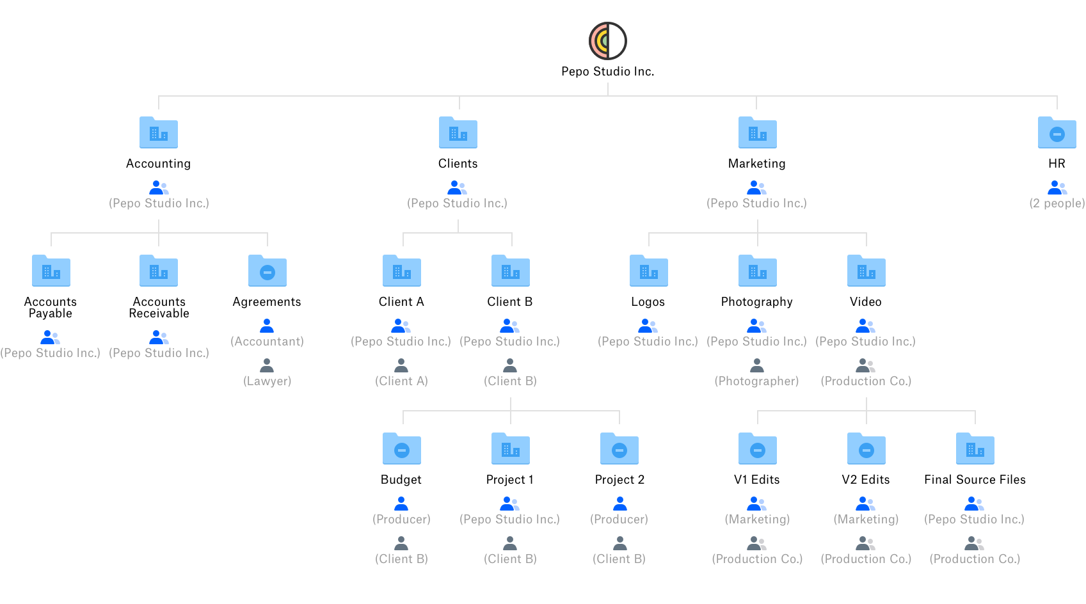

Slide 4
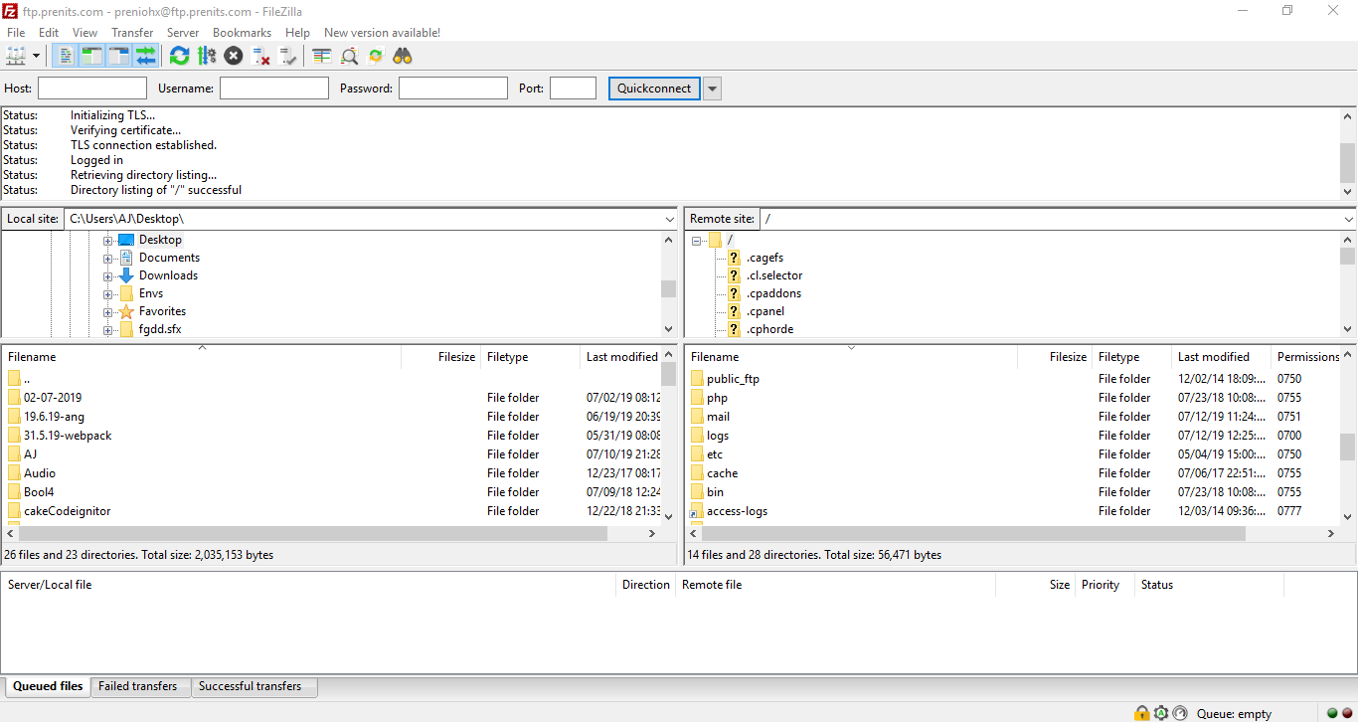

Slide 5
We need Version Control System !
Centralized version control system (CVCS)
Distributed version control system

Slide 6
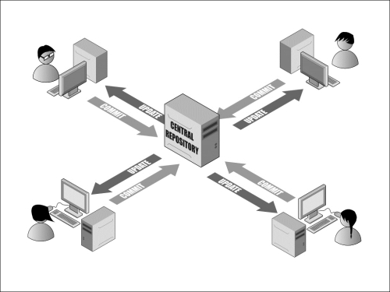
Centralized version control system (CVCS)

Slide 7
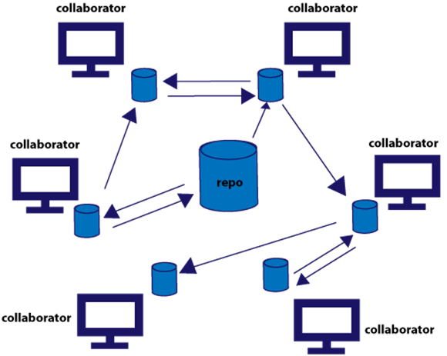
Distributed version control system

Slide 8

Centralized version control system (CVCS)
Distributed version control system

Slide 9
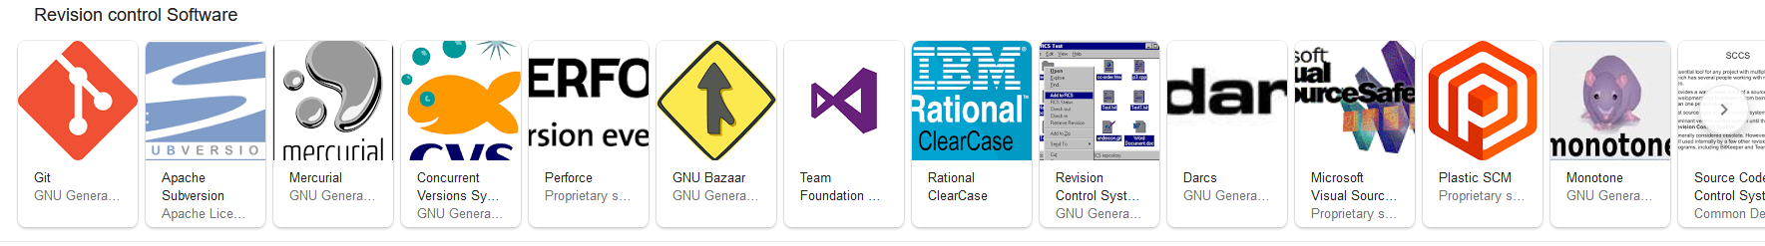
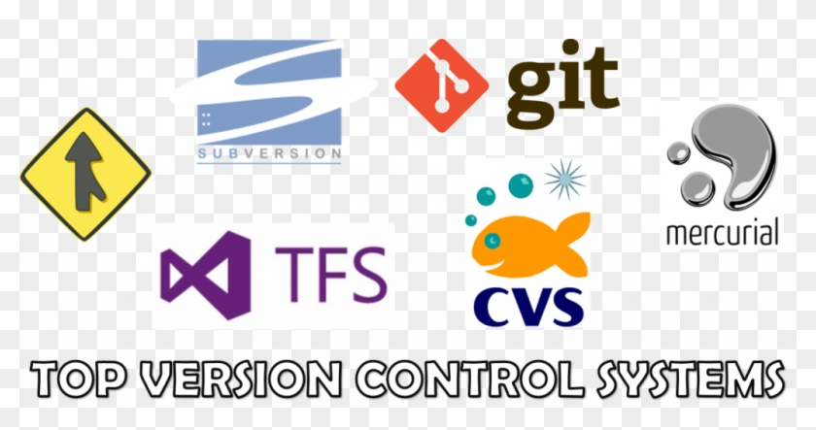
Version Control System

Slide 10
Git
Get Started

Slide 11


Software Requirements
GitHub Account
Git Software

Slide 12
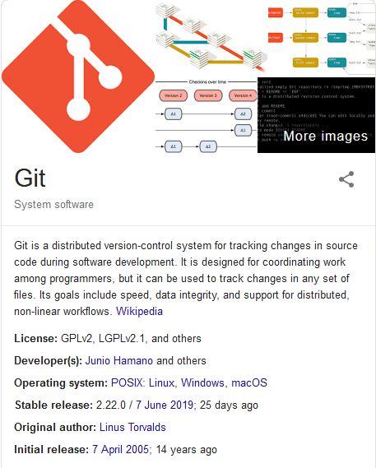
Introduction
Git is a free and open source distributed version control system designed to handle everything from small to very large projects with speed and efficiency.
Git is easy to learn and has a tiny footprint with lightning fast performance. It outclasses SCM tools like Subversion, CVS, Perforce, and ClearCase with features like cheap local branching, convenient staging areas, and multiple workflows.

Slide 13

Git
Introduction about Version Control System.

Slide 14
Git Hub
Introduction

Slide 15

Introduction

Slide 16
GitHub
What is GitHub ?

Slide 17
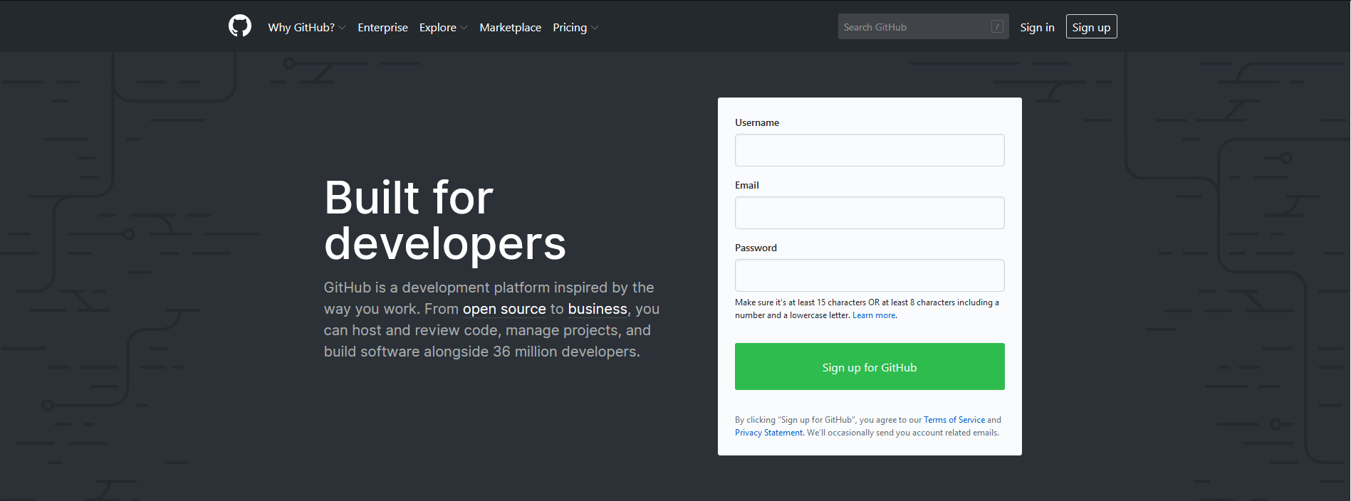
Steps -
1. Create GitHub Account

Slide 18
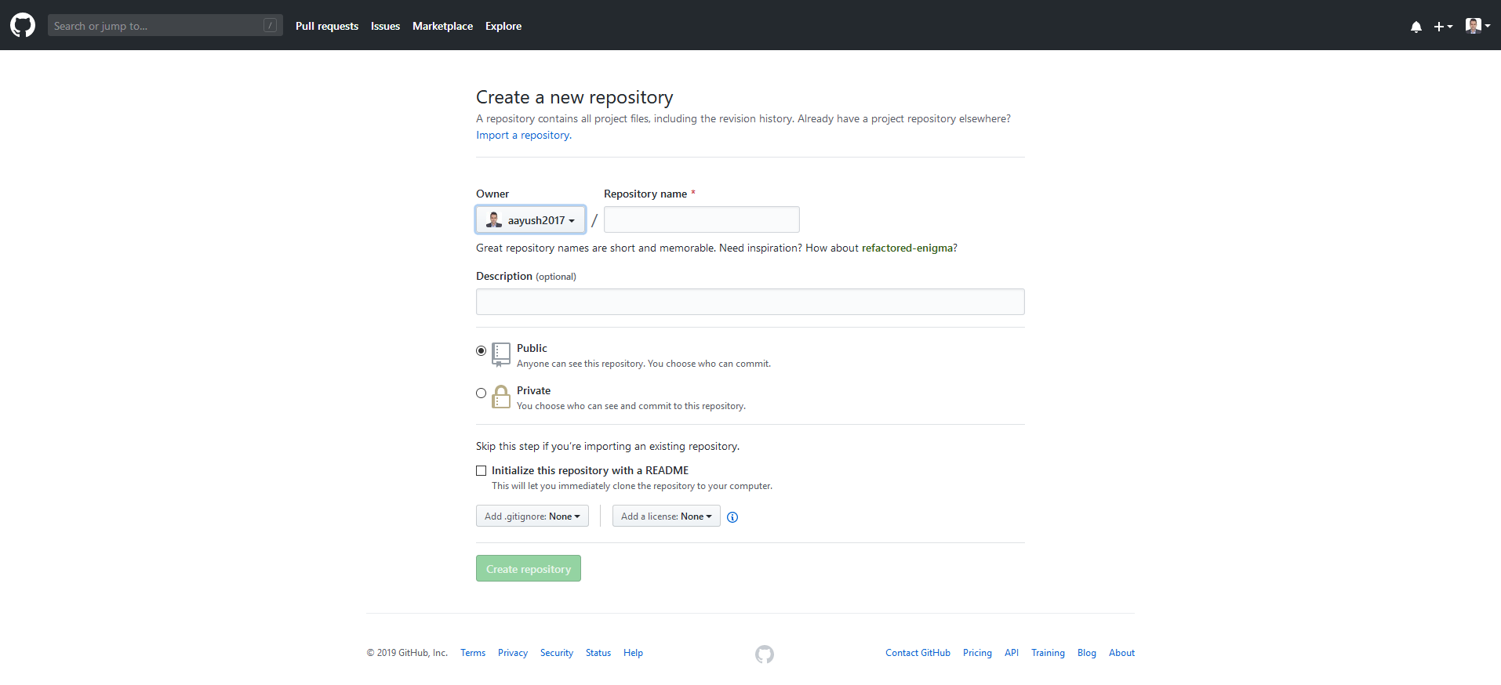
Steps -
2. Create Repository

Slide 19
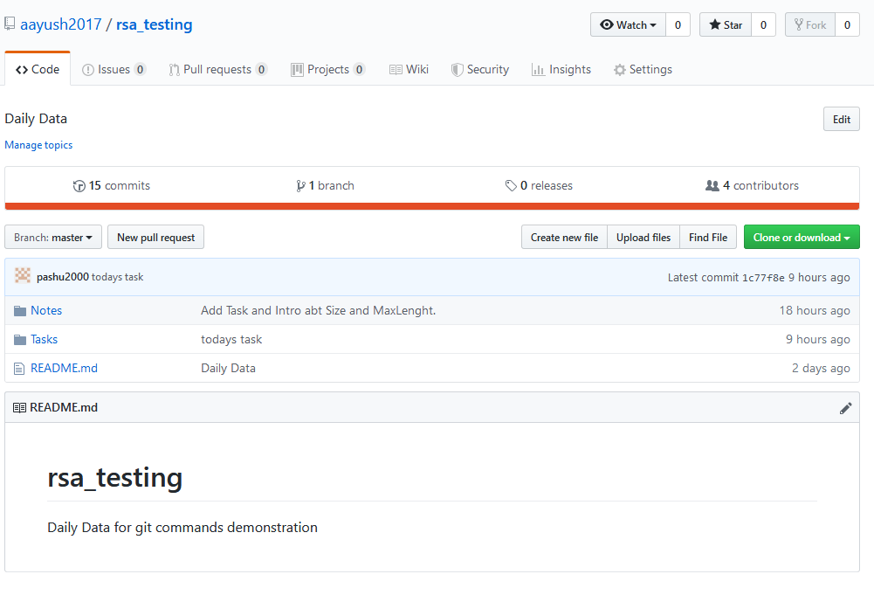
Steps -
3. Code Repository

Slide 20
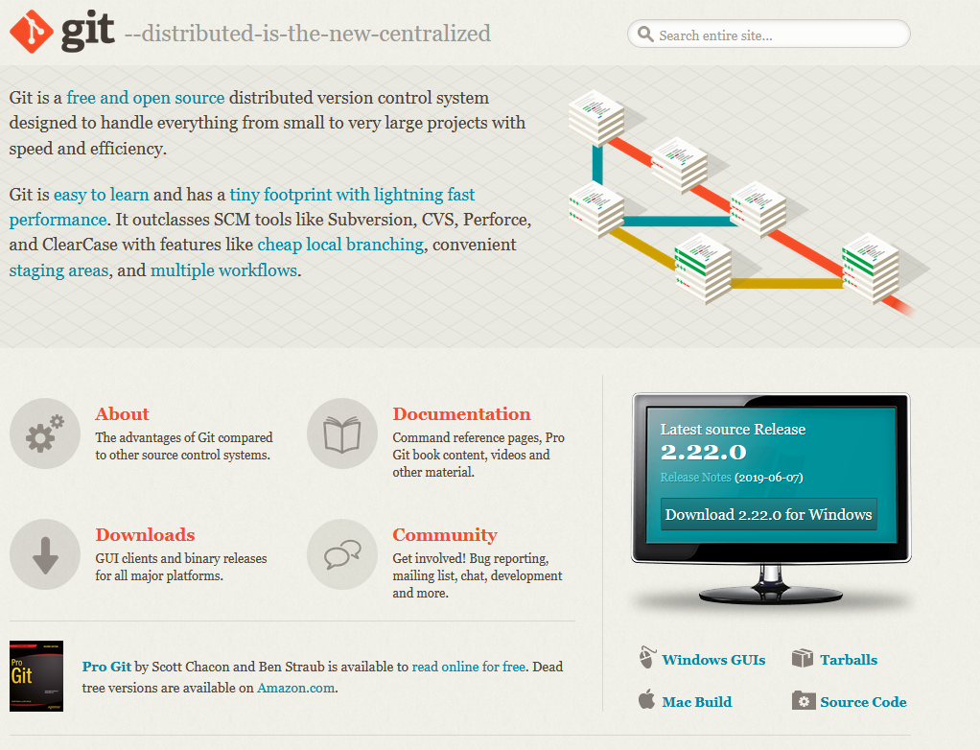
Steps -
4. Download Git Software & Install.

Slide 21

Git
What is Git ?

Slide 22
Command for First
Open Command Prompt --> win + R --> cmd
2. Goto on working Directory.
3. Git clone <URL>
3. git config --global user.email “your GitHub email ID“
4. git config --global user.name “your GitHub UserID"

Slide 23
Basic Command
git status
2. Git add .
3. Git commit –m “Your message”
4. git push

Slide 24

Git
Get Going !

Slide 25
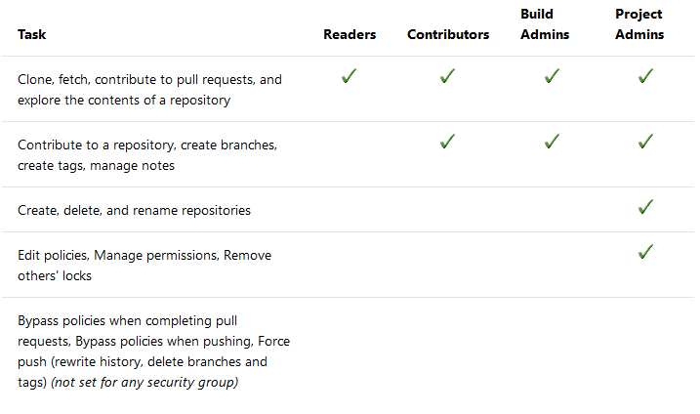
Git
You can use Git repositories to host and collaborate on your source code. For an overview of code features and functions, see Git.
Set permissions across all Git repositories by making changes to the top-level Git repositories entry. Individual repositories inherit permissions from the top-level Git Repositories entry. Branches inherit a subset of permissions from assignments made at the repository level. For branch permissions and policies, see Set branch permissions and Improve code quality with branch policies.
The Project Collection Build Service can read from all repositories by default. Any pipeline which runs with project collection scope can potentially read any repository in the organization/collection. You can remove this permission for a repository: set "Read" to "Deny" for the Project Collection Build Service.

Slide 26
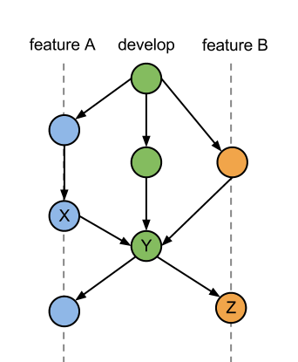
More Features

Slide 27
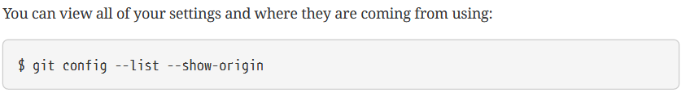
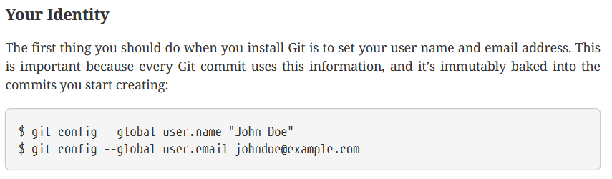
Commands

Slide 28
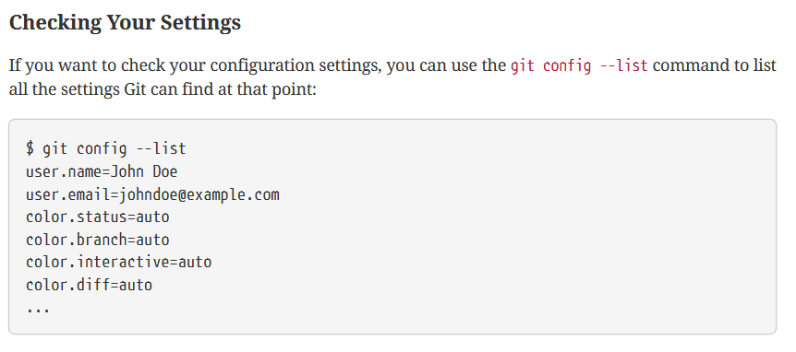
Commands

Slide 29
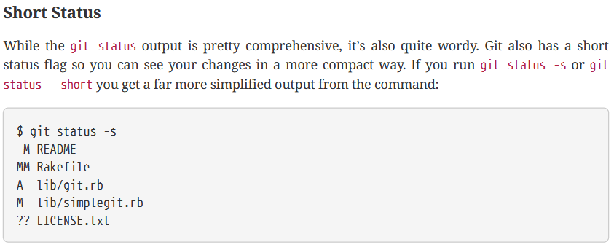
Commands

Slide 30
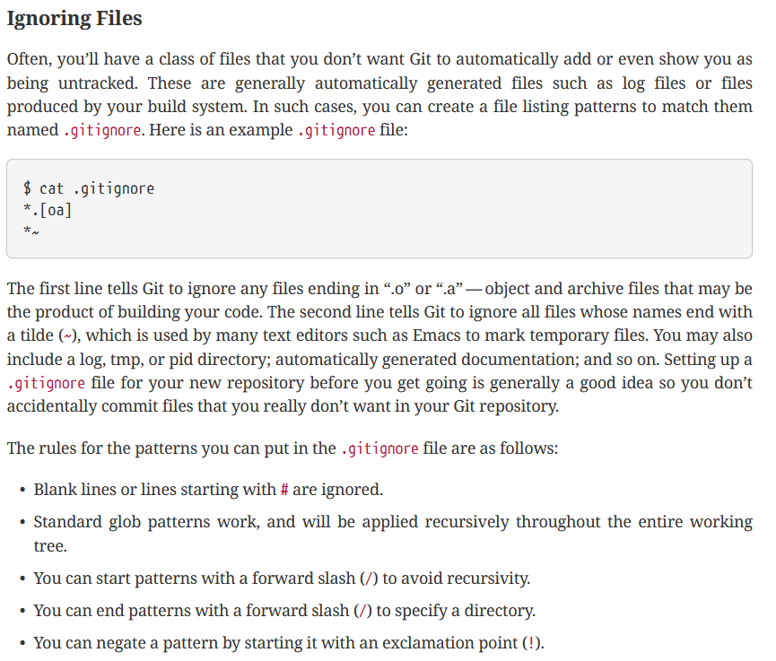
Commands

Slide 31
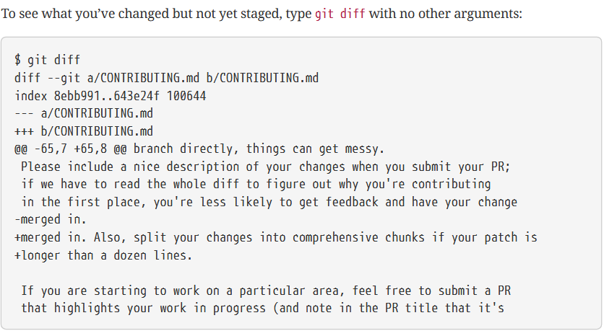
Commands

Slide 32
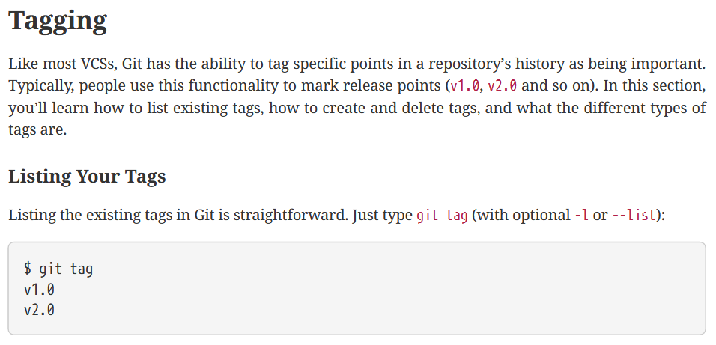
Commands

Slide 33
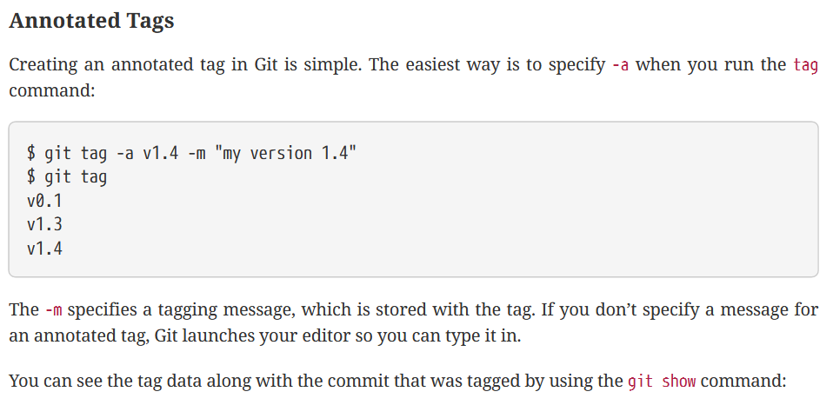
Commands

Slide 34
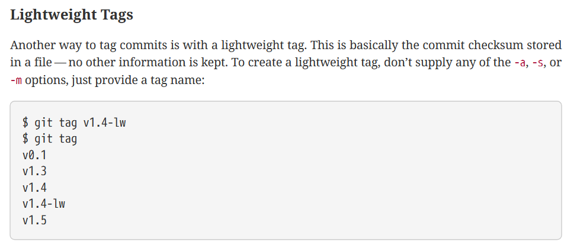
Commands

Slide 35
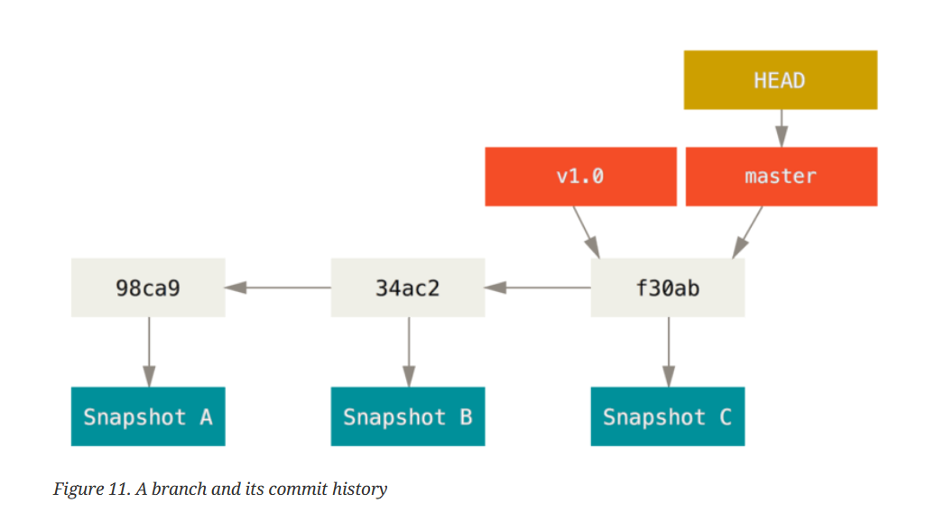
Commands

Slide 36
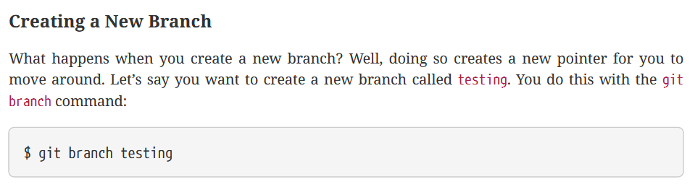
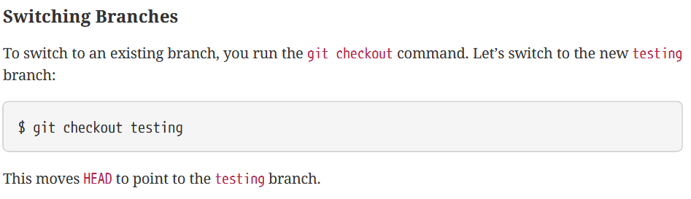
Commands

Slide 37
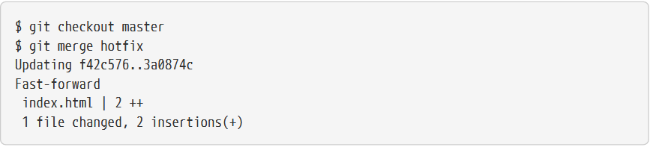
Commands

Slide 38
Commands
Git add
Git rm
Git mv
Git log
Git remote
Git remote –v
Git branch

Slide 39
Thank you

